Slide 1
SS1 TEAM 7 HybridSort & MergeSort
Janesse
Shi Han
Brandon
Liya
Implementation
Analysis
Conclusion
Hybrid & MergeSort
Time Complexity & Key Comparisons
Optimal Value of S

Slide 2
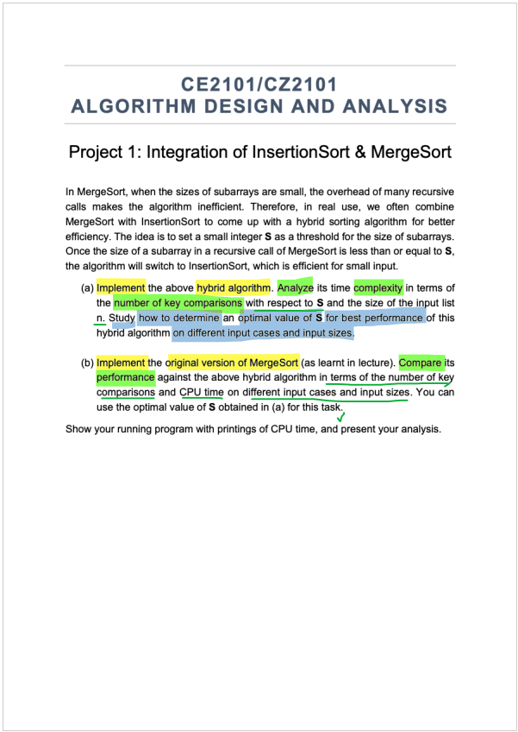
Notes:
Part a
implement algo
- time complexity graph
- key comparison graph
- find optimal S (& sample size)
Part b (Use optimal S)
Implement algo
Time complexity graph
Key comparison graph

Slide 3
(a) Overview
Best Performance
4
Optimal S value
S across 3 cases
3
CPU Time Case Study
Wrt n & s
2
Key Comparisons
Algorithm
Hybrid Implementation
1

Slide 4
(b) Overview
Comparing Performances
4
Analysis
Wrt to input cases & sizes
3
CPU Time Case Study
Wrt N values (S fixed)
2
Key Comparisons
Algorithm
MergeSort Implementation
1

Slide 5
(a) Overview
Algorithm
Hybrid Implementation
1

Slide 6
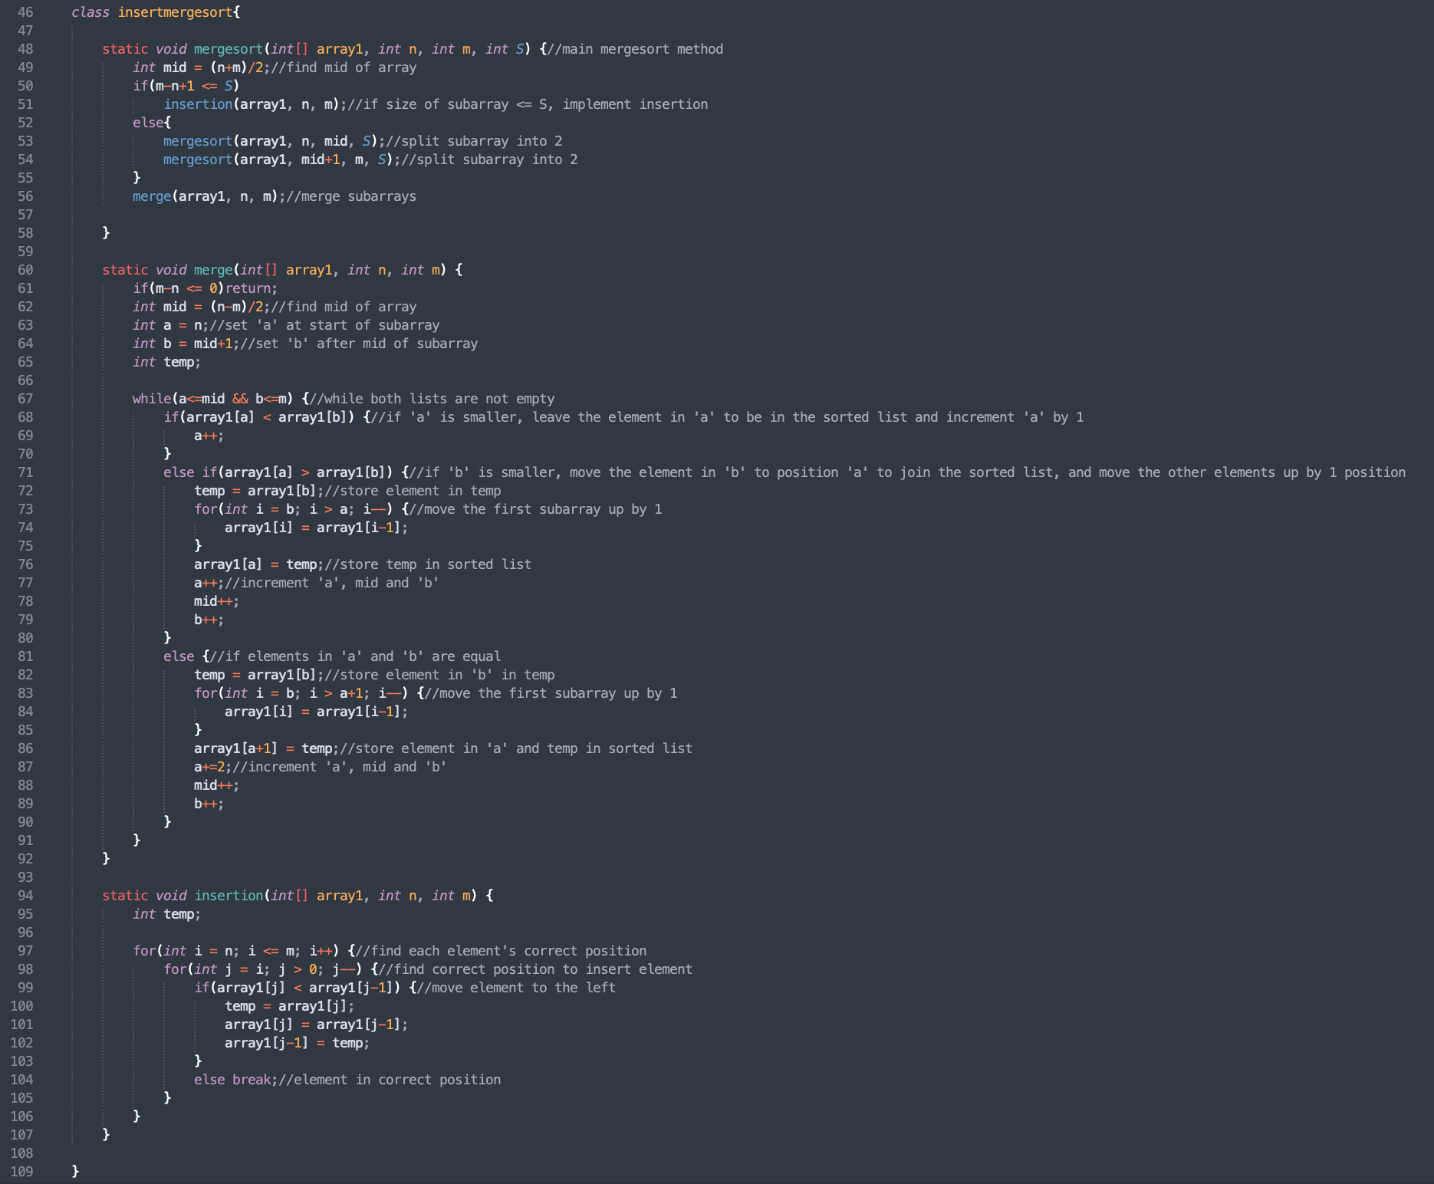
HybridSort

Slide 7
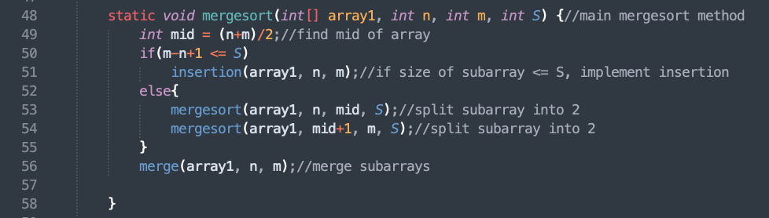
MergeSort

Slide 8
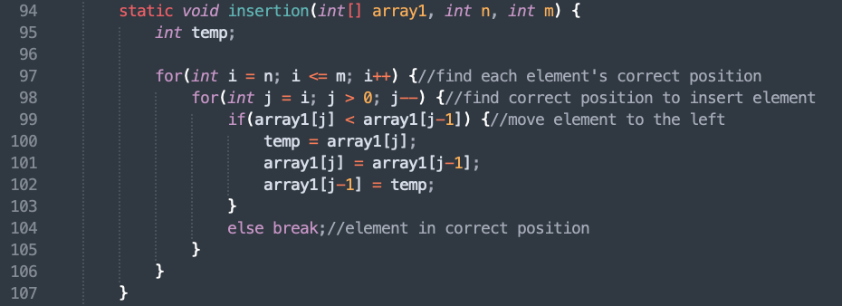
InsertionSort

Slide 9
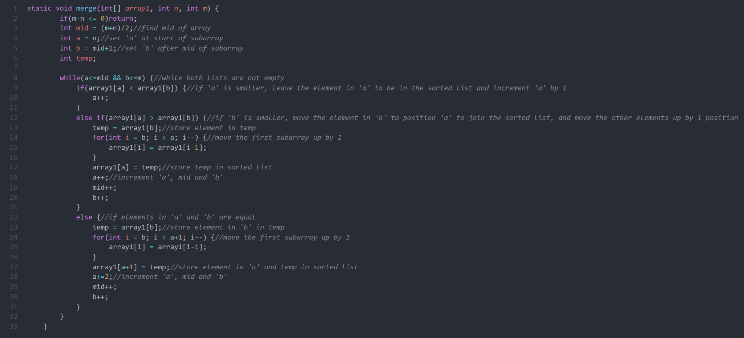
Merge

Slide 10
(a) Overview
Wrt s & n
2
Key Comparisons
Algorithm
Hybrid Implementation
1

Slide 11
HybridSort Tree
# Key Cmps
W(n)
n - 1
n - 1
n - 2
n - 4
n - 2^{k-1}
(S = 2^{k})
W(n/2)
n/2 - 1
W(n/2)
n/2 - 1
Merge Sort
Insertion Sort
W(n/4)
n/4 - 1
W(n/4)
n/4 - 1
W(n/4)
n/4 - 1
W(n/4)
n/4 - 1
….
W(n/2^{k-1})
n/2^{k-1} - 1
W(n/2^{k-1})
n/2^{k-1} - 1
…………...
W(n/2^{k-1})
n/2^{k-1} - 1
O(S²)
O(S²)
…………...
O(S²)
n/S subarrays

Slide 12
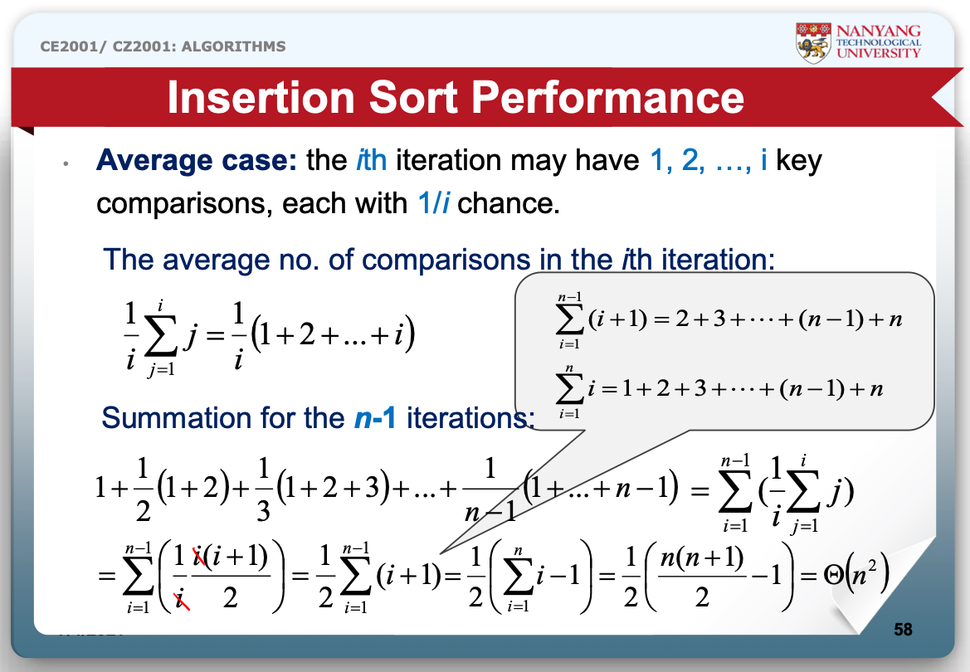
Insertion Sort Generally

Slide 13
Insertion Sort Portion
1
Average # of cmps in i-th iteration / sub-array
2
∑ of (s-1) iterations / sub-array
3
* (n/s) sub-arrays

Slide 14
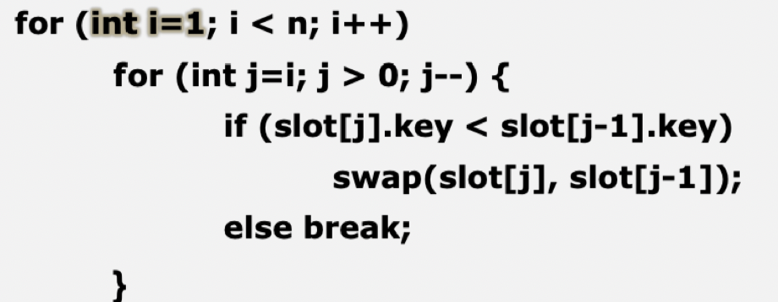
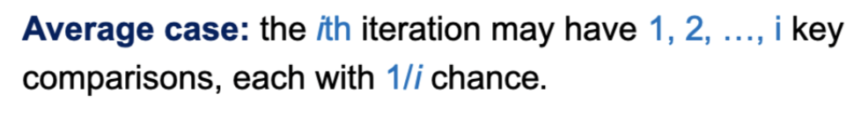
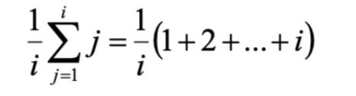
Insertion Sort Portion
1

Slide 15
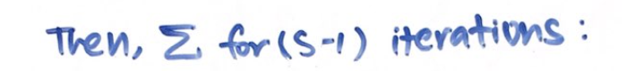
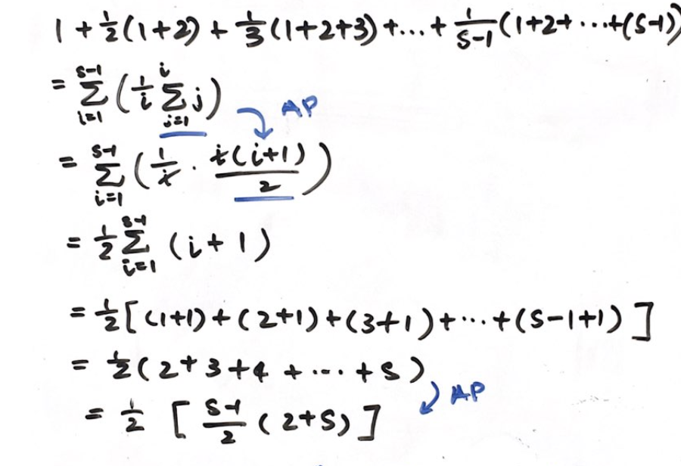
Insertion Sort Portion
2
Notes:
(s-1) iterations in the outer loop
Ie for(int i = 1; i < s; i ++)

Slide 16
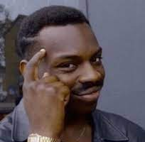
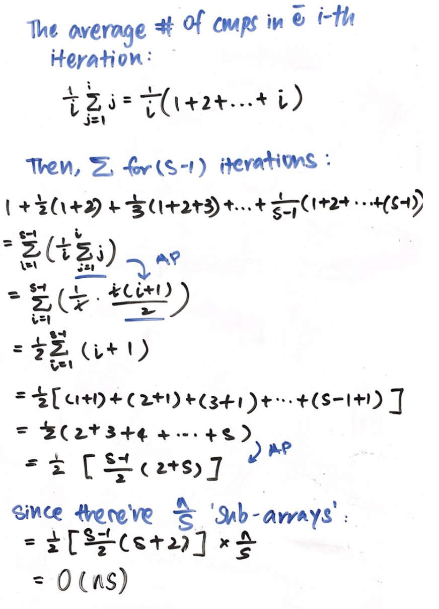
Insertion Time-Complexity
O(S²)
O(S²)
…………...
O(S²)
n/S subarrays
3

Slide 17
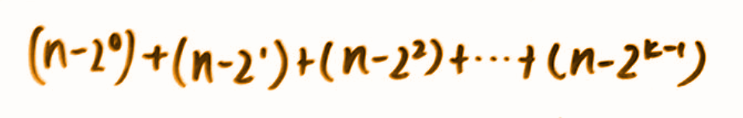
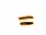
MergeSort Portion
# Key Cmps
W(n)
n - 1
n - 1
n - 2
n - 4
n - 2^{k-1}
W(n/2)
n/2 - 1
W(n/2)
n/2 - 1
W(n/4)
n/4 - 1
W(n/4)
n/4 - 1
W(n/4)
n/4 - 1
W(n/4)
n/4 - 1
….
W(n/2^{k-1})
n/2^{k-1} - 1
W(n/2^{k-1})
n/2^{k-1} - 1
…………...
W(n/2^{k-1})
n/2^{k-1} - 1
Notes:
K i sthe height of the tree

Slide 18
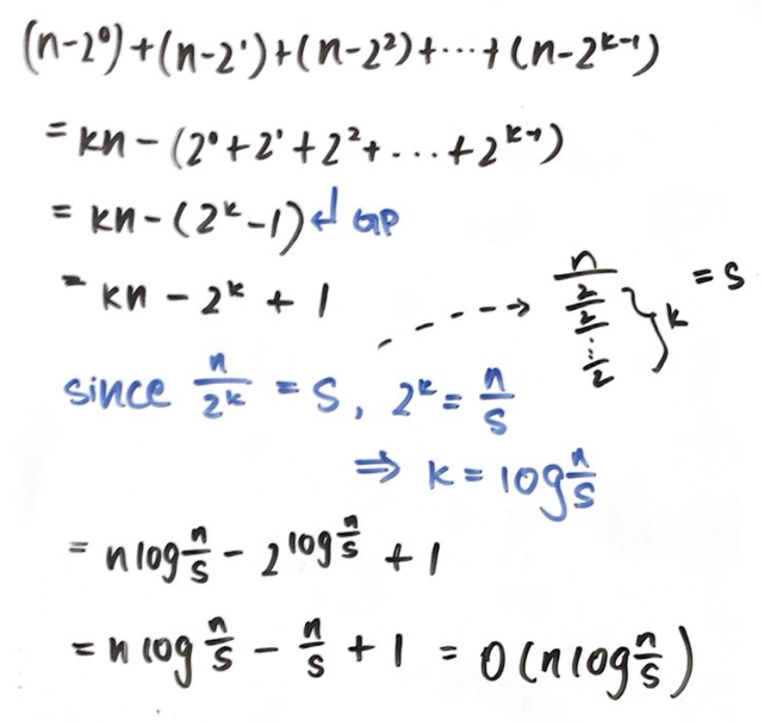

MergeSort Portion - Time Complexity

Slide 19

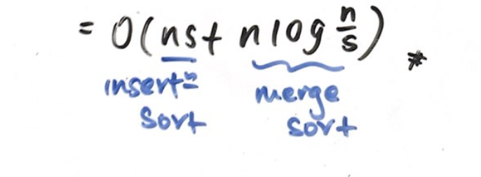
Hybrid Time-Complexity

Slide 20
(a) Overview
S across 3 cases
3
CPU Time Case Study
Wrt varying n & s
2
Key Comparisons
Algorithm
Hybrid Implementation
1

Slide 21
3 Different Cases
2018
Case 1
Sorted Array
2019
Case 2
Reversely Sorted Array
2020
Case 3
Arbitrary Array

Slide 22
S \ N | 999 | 9999 | 99999
5 | 449437 | 915188 | 2389834
10 | 364125 | 796285 | 1943547
15 | 263665 | 838044 | 1940538
20 | 254126 | 690657 | 2008276
25 | 247953 | 645710 | 1605590
30 | 276627 | 819559 | 2173133
35 | 280446 | 1022783 | 1998354
40 | 240478 | 780459 | 1675498
45 | 316474 | 900461 | 1745992
50 | 242283 | 702888 | 2353083
2018
Case 1
Sorted Array
Notes:
999: 449437 364125 263665 254126 248153 276627 280446 37628 316474 242283
449437 364125 263665 254126 247953 276627 280446 240478 316474 242283
9999 : 915188 796285 838044 690657 645710 819559 1022783 780459 900461 702888
915188 796285 838044 690657 645710 819559 1022783 780459 900461 702888
99999: 2014519 1982764 1761528 3629695 1605590 2173133 1842664 1690887 1591483 1614165
2389834 1943547 1940538 2008276 1605590 2173133 1998354 1675498 1745992 2353083

Slide 23
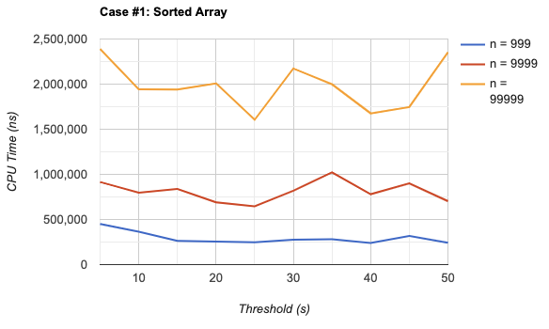
2018
Case 1
Sorted Array

Slide 24
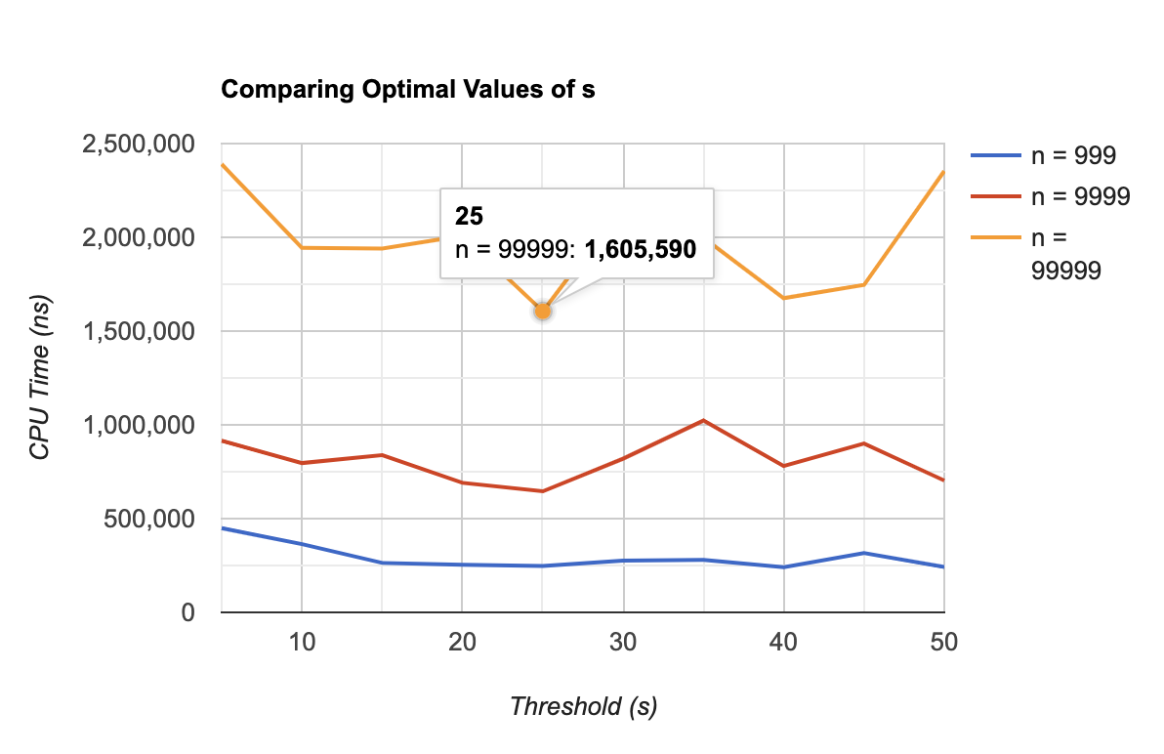
2018
Case 1
Sorted Array

Slide 25
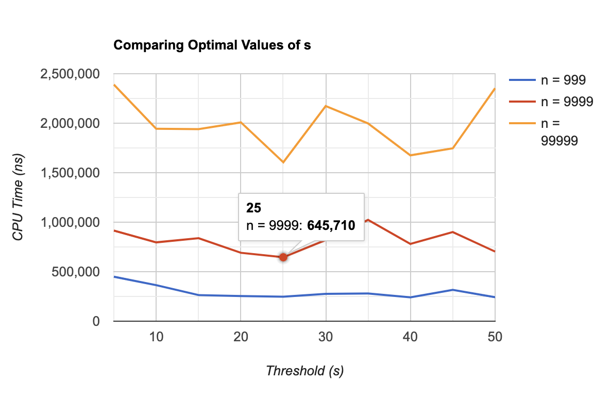
2018
Case 1
Sorted Array

Slide 26
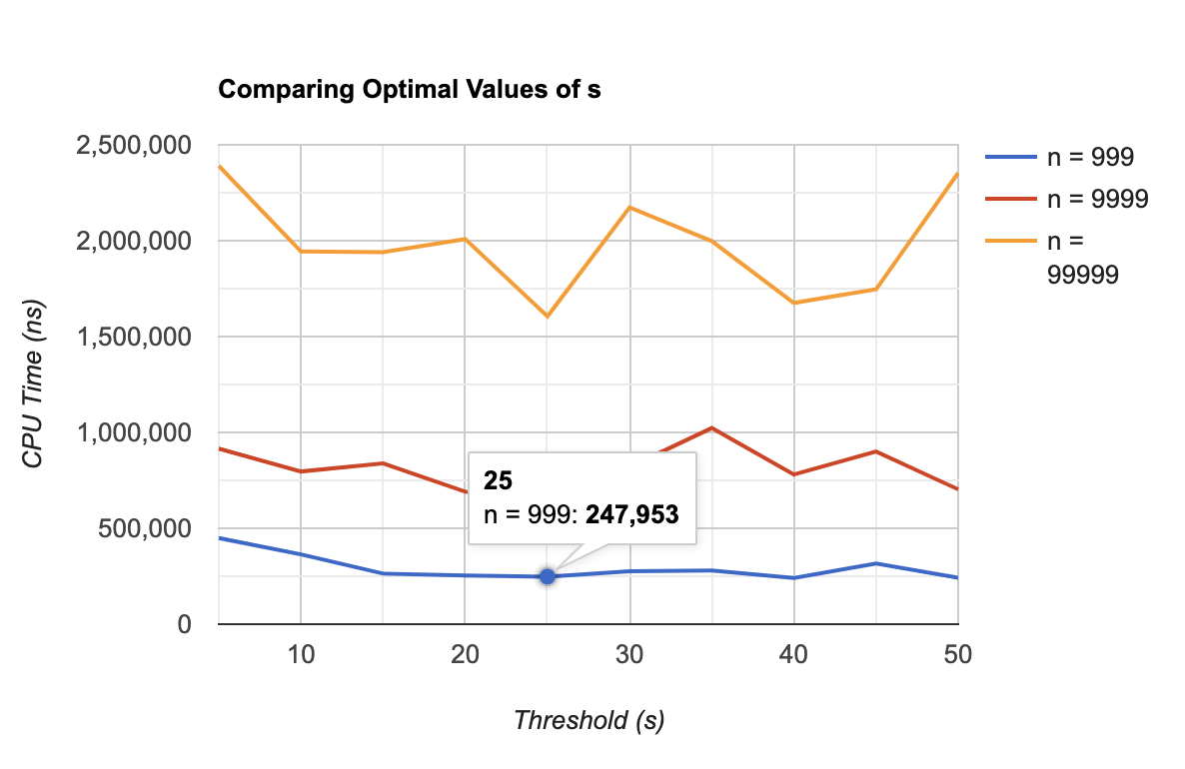
2018
Case 1
Sorted Array

Slide 27
Optimal S = 25
2018
Case 1
Sorted Array
Notes:
https://www.rapidtables.com/tools/line-graph.html

Slide 28
S \ N | 999 | 9999 | 99999
5 | 5930592 | 36694709 | 6129175073
10 | 4472130 | 89044177 | 6509508378
15 | 4611895 | 104286851 | 6379388320
20 | 4386897 | 105550977 | 6131762957
25 | 4492571 | 76705192 | 6184229387
30 | 4437417 | 58714348 | 6036543295
35 | 4471463 | 104382832 | 6404845561
40 | 4457360 | 111180648 | 6156412736
45 | 4474233 | 37687457 | 6112487697
50 | 4436838 | 105989680 | 6310169521
2019
Case 2
Reversely Sorted Array
Notes:
999: 5930592 4472130 4611895 4386897 4492571 4437417 4471463 4457360 4474233 4436838
9999: 36694709 89044177 104286851 105550977 76705192 58714348 104382832 111180648 37687457 105989680
99999: 6129175073 6509508378 6379388320 6131762957 6184229387 6036543295 6404845561 6156412736 6112487697 6310169521

Slide 29
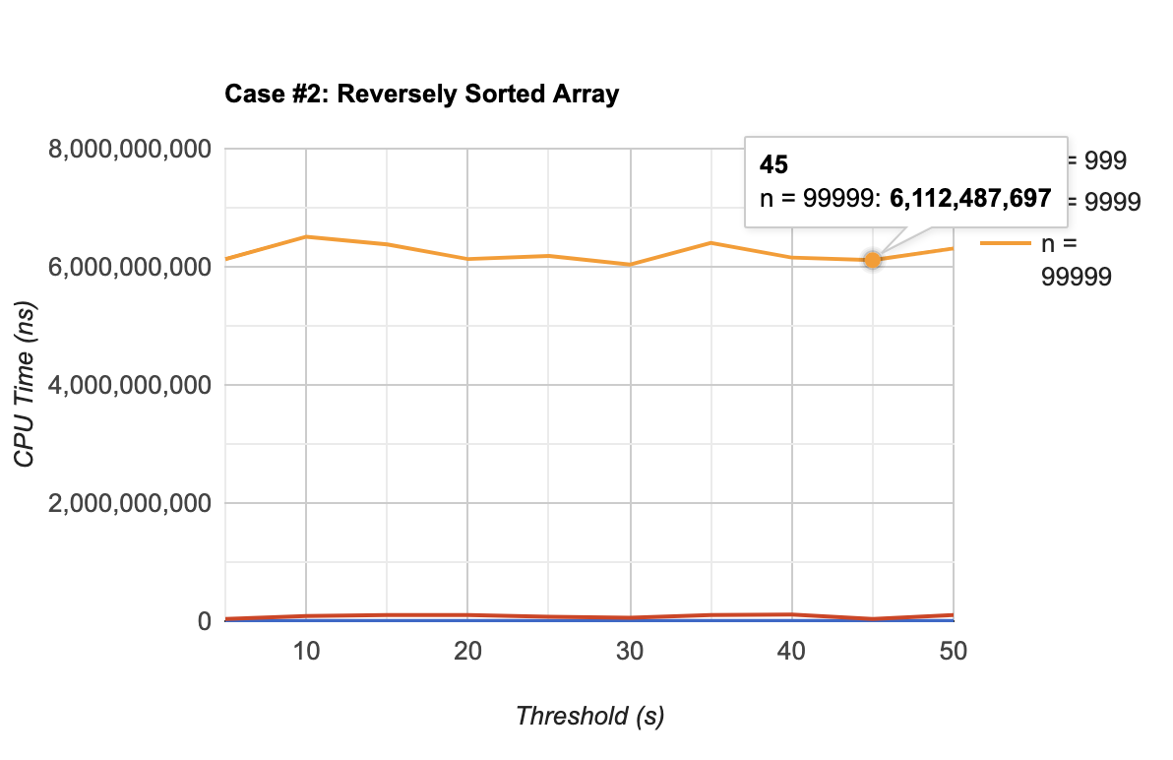
2019
Case 2
Reversely Sorted Array

Slide 30
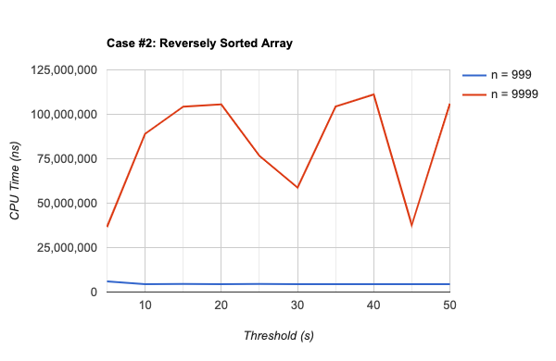
2019
Case 2
Reversely Sorted Array

Slide 31
Optimal S = 45
2019
Case 2
Reversely Sorted Array
Notes:
https://www.rapidtables.com/tools/line-graph.html

Slide 32
S \ N | 999 | 9999 | 99999
5 | 3241201 | 24539401 | 1578699179
10 | 4179247 | 27592815 | 1555091141
15 | 4700987 | 25828673 | 1528434275
20 | 4515496 | 25147193 | 1594815779
25 | 4176029 | 25498138 | 1552509967
30 | 3677258 | 25074012 | 1559160449
35 | 3594741 | 27263694 | 1553523655
40 | 4567930 | 24922676 | 1554906073
45 | 3741376 | 31834428 | 1554952968
50 | 3934926 | 25681608 | 1559242186
2020
Case 3
Arbitrary Array
Notes:
999: 3241201 4179247 4700987 4515496 4176029 3677258 3594741 4567930 3741376 3934926
9999 : 24539401 27592815 25828673 25147193 25498138 25074012 27263694 24922676 31834428 25681608
99999: 1578699179 1555091141 1528434275 1594815779 1552509967 1559160449 1553523655 1554906073 1554952968 1559242186

Slide 33
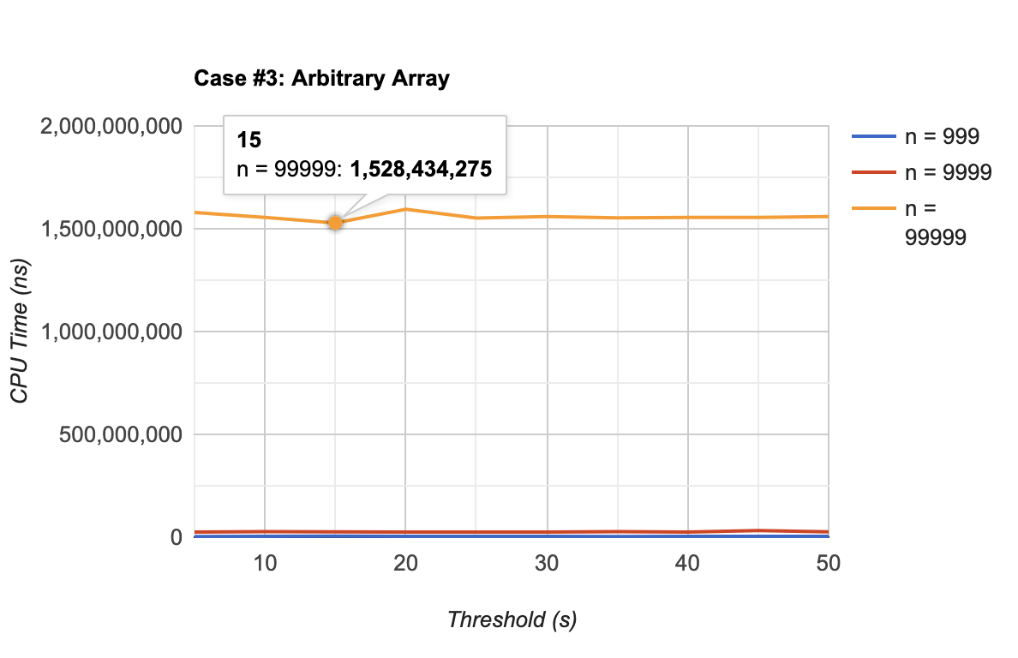
2020
Case 3
Arbitrary Array

Slide 34
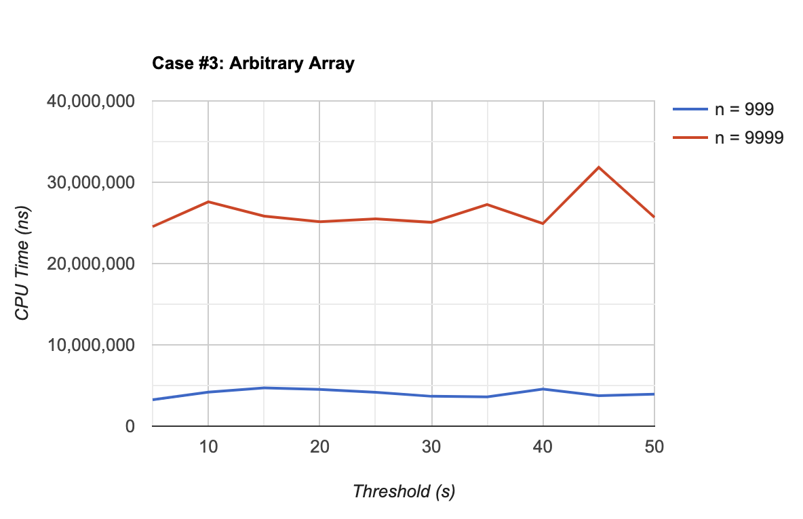
2020
Case 3
Arbitrary Array

Slide 35
Optimal S = 15
2020
Case 3
Arbitrary Array

Slide 36
(a) Overview
Best Performance
4
Optimal S value
S across 3 cases
3
CPU Time Case Study
Wrt n & s
2
Key Comparisons
Algorithm
Hybrid Implementation
1

Slide 37
(b) Overview
Algorithm
MergeSort Implementation
1

Slide 38
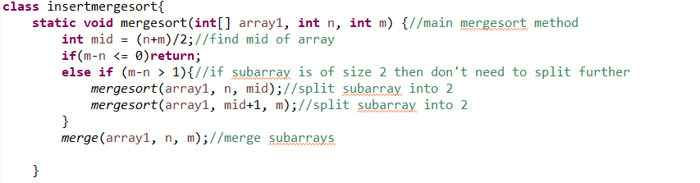
Mergesort Algorithm

Slide 39
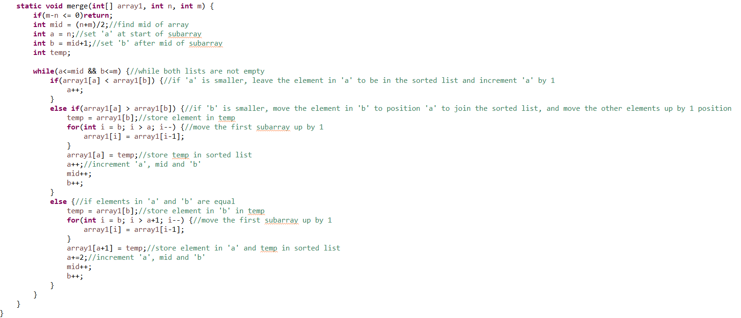
Mergesort Algorithm

Slide 40
(b) Overview
Wrt N values (S fixed)
2
Key Comparisons
Algorithm
MergeSort Implementation
1

Slide 41
MergeSort Algorithm
2018
Case 1
Sorted Array
Array size (N) | 999 | 9999 | 99999
Key Comparison | 5041 | 69001 | 853896
Array size (N) | 999 | 9999 | 99999
Key Comparison | 4924 | 64600 | 815014
2019
Case 2
Reversely Sorted Array
2020
Case 3
Array size (N) | 999 | 9999 | 99999
Key Comparison | 8319 | 116742 | 1498366
Arbitrary Array

Slide 42
(b) Overview
Wrt to input cases & sizes
3
CPU Time Case Study
Wrt N values (S fixed)
2
Key Comparisons
Algorithm
MergeSort Implementation
1

Slide 43
MergeSort Algorithm
2018
Case 1
Sorted Array
Array size (N) | 999 | 9999 | 99999
CPU Time (ns) | 495 812 | 1 134 001 | 3 961 191
Array size (N) | 999 | 9999 | 99999
CPU Time (ns) | 223 5484 | 6 734 9327 | 3 137 007 016
2019
Case 2
Reversely Sorted Array
2020
Case 3
Arbitrary Array
Array size (N) | 999 | 9999 | 99999
CPU Time (ns) | 1 481 735 | 72 820 156 | 1 715 168 138

Slide 44
(b) Overview
Comparing Performances
4
Analysis
Wrt to input cases & sizes
3
CPU Time Case Study
Wrt N values (S fixed)
2
Key Comparisons
Algorithm
MergeSort Implementation
1

Slide 45
2020
Comparing MergeSort and Hybrid (Key Comparison)
 | MergeSort | Hybrid (S = 15)
999 | 8319 | 251112
9999 | 116742 | 31337100
99999 | 1498366 | 2499505189
Notes:
Implementation of Hybrid

Slide 46
2020
Comparing MergeSort and Hybrid (CPU Time)
 | MergeSort | Hybrid (S = 15)
999 | 1 481 735 | 4 700 987
9999 | 72 820 156 | 25 828 673
99999 | 1 715 168 138 | 1 528 434 275
Notes:
Implementation of Hybrid

Slide 47
Conclusion
Hybrid Sort has lower CPU time usage but higher key comparisons
When the subarrays are smaller, the overhead of recursive calls make the MergeSort algorithm more inefficient.
For a certain threshold S, InsertionSort has a quicker execution time compared to MergeSort. Hence, by merging both sorting algorithms, the total runtime will be optimized.

Slide 48

END

Slide 49
Case 1: Sorted Array

Slide 50
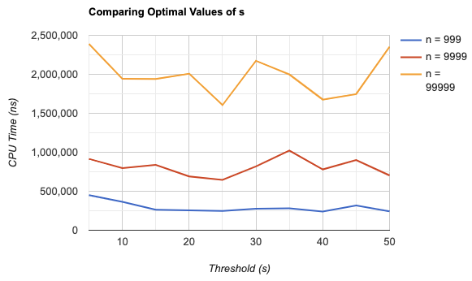

Slide 55
Optimal S = 25
Notes:
https://www.rapidtables.com/tools/line-graph.html

Slide 56
Case 2: Reversely Sorted Array

Slide 57
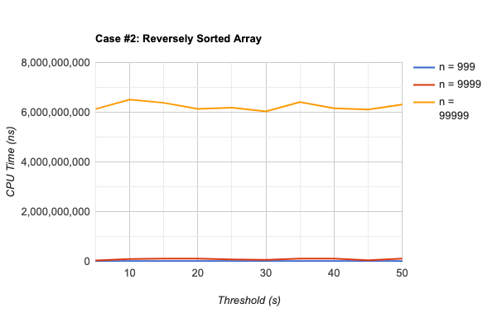

Slide 60
Case 3: Arbitrary Array

Slide 61
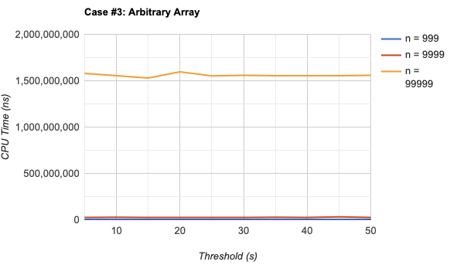

Slide 64
Optimal s = ???

Slide 65
Input Size / CPU time
99
999
9999
99999
999999

Slide 69
Hand-Drawn Timeline Infographics
Neptune
Earth
Saturn
Neptune is the farthest planet from the Sun. It is the fourth-largest
Earth is the third planet from the Sun. It’s where we all live on
Saturn is one of the biggest planets. It has several rings

Slide 70
Hand-Drawn Timeline Infographics
MERCURY
VENUS
JUPITER
Mercury is the closest planet to the Sun and
the smallest one in the Solar System
Venus has a good name and is the
second planet from the Sun. It’s hot
It’s a gas giant and the biggest planet in the Solar System. It’s the fourth-brightest
2018
2019
2020

Slide 71
Hand-Drawn Timeline Infographics
Neptune
Neptune
Neptune
Mercury is the closest planet to the Sun and
the smallest one in the Solar System
Venus has a good name and is the
second planet from the Sun. It’s hot
It’s a gas giant and the biggest planet in the Solar System. It’s the fourth-brightest

Slide 72
Hand-Drawn Timeline Infographics
2018
2019
2020
2021
Neptune is the farthest planet from the sun. It is the fourth-largest
Earth is the third planet from the Sun. It’s where we all live on
Saturn is one of the biggest planets. It has several rings
Mercury is the closest planet to the Sun. It’s very hot

Slide 73
Hand-Drawn Timeline Infographics
Neptune
Mars
Jupiter
Saturn
Neptune is the farthest planet from the Sun. It is also the fourth-largest
Despite being red, Mars is actually a cold place. It’s full of iron oxide dust
Jupiter is a gas giant and the biggest planet in the Solar System
Yes, this is the ringed one. It’s a gas giant, made of hydrogen and helium

Slide 74
Hand-Drawn Timeline Infographics
2018
2019
2020
2021
Neptune
Mars
Jupiter
Saturn
Neptune is the farthest planet from the Sun. It is also the fourth-largest
Despite being red, Mars is actually a cold place. It’s full of iron oxide dust
Jupiter is a gas giant and also the biggest planet in the Solar System
Yes, this is the ringed one. It’s a gas giant, made of hydrogen and helium

Slide 75
Hand-Drawn Timeline Infographics
2016
2018
2020
2022
Neptune
Mars
Jupiter
Saturn
Neptune is the farthest planet from the Sun. It is the fourth-largest planet
Despite being red, Mars is actually a cold place. It’s full of iron oxide dust
Jupiter is a gas giant and also the biggest planet in the Solar System
Yes, this is the ringed one. It’s a gas giant, made of hydrogen
and helium

Slide 76
Hand-Drawn Timeline Infographics
2018
2019
2020
2021
EARTH
NEPTUNE
MERCURY
VENUS
Earth is the third planet from the Sun
Neptune is the farthest planet from the Sun
Mercury is the closest planet to the Sun
Venus is the second planet from the Sun

Slide 77
Hand-Drawn Timeline Infographics
2012
2014
2016
2018
2020
Saturn
Mercury
Neptune
Jupiter
Venus
Saturn is a gas giant and has several rings
Mercury is the closest planet to the Sun
Neptune is the farthest planet from the Sun
It’s a gas giant and the biggest in the Solar System
Venus is the second planet from the Sun
1
2
3
4
5

Slide 78
Hand-Drawn Timeline Infographics
2016
2018
2020
Earth is the third planet from the Sun
Saturn is a gas giant and has several rings
Neptune is the farthest planet
from the Sun
Despite being red, Mars is
a cold place
Mercury is the closest planet to the Sun
2017
2019

Slide 79
Hand-Drawn Timeline Infographics
2018
2020
Earth is the third planet from the Sun
Saturn is a gas giant and has several rings
Neptune is the farthest planet
from the Sun
Despite being red, Mars is a cold place
Mercury is the closest planet to the Sun
2017
2019
2021

Slide 80
Hand-Drawn Timeline Infographics
30%
70%
Neptune is the farthest planet from the Sun
Despite being red, Mars is a cold place
Mercury is the closest planet to the Sun
Saturn
Earth
1
2
3
4
5
Saturn is a gas giant and has several rings
Earth is the fourth planet from the Sun
Neptune
Mars
Mercury
20%
55%
80%

Slide 81
Hand-Drawn Timeline Infographics
Venus is the second planet from the Sun
It’s one of the biggest planets. It is a gas giant
Earth is the planet where we all live on
Venus
Saturn
Earth
Neptune
Mercury
Mars
Neptune is the farthest planet
from the Sun
Mercury is the closest planet
to the Sun
Despite being red, Mars is
a cold place

Slide 82
Hand-Drawn Timeline Infographics
2018
2020
Neptune is the farthest from the Sun
Earth is the third planet from the Sun
2019
2021
Despite being red, Mars is cold
Saturn is a gas giant and has rings

Slide 83
Hand-Drawn Timeline Infographics
A
B
C
Neptune
Venus
Saturn
Neptune is the farthest planet
from the Sun
Venus is the second planet from the Sun
It’s one of the biggest planet. It is a gas giant

Slide 84
Hand-Drawn Timeline Infographics
Saturn is one of the biggest planets. It has several rings
Mercury is the smallest planet in the entire Solar System
Saturn
Mercury
Neptune
Earth
Neptune is the farthest planet from the Sun. It is the fourth-largest
Earth is the third planet from the Sun. It is the planet that harbors life

Slide 85
Hand-Drawn Timeline Infographics
Neptune
Mars
Earth
Neptune is the farthest planet from the Sun
Despite being red, Mars is actually a cold place
Earth is the third planet. It is the planet we live on
Mercury
Saturn
Mercury is the closest planet to the Sun
Saturn is one of the biggest planets. It is a gas giant

Slide 86
Hand-Drawn Timeline Infographics
Venus
Mars
Venus is the second planet from the Sun
Despite being red, Mars is a very cold place
2
3
4
1
Neptune
Jupiter
Neptune is the farthest planet from the Sun
Jupiter is a gas giant and the biggest planet

Slide 87
Hand-Drawn Timeline Infographics
2018
Venus
Venus is the second planet from the Sun
2019
Mercury
Mercury is the closest planet to the Sun
2020
Neptune
Neptune is the farthest planet from the Sun

Slide 88
Hand-Drawn Timeline Infographics
A
Venus is the second planet from the Sun
2018
Earth is the third planet and is where we live on
B
2019
C
Neptune is the farthest planet from the Sun
2020
Mercury is the closest planet to the Sun
D
2021

Slide 89
Hand-Drawn Timeline Infographics
Neptune is the farthest planet from the Sun
Neptune
1
2
Mercury
Mercury is the closest planet to the Sun
Despite being red, Mars is a cold place
Mars
3
4
Saturn
Saturn is the ringed one and a gas giant
It’s the third planet from the Sun
Earth
5

Slide 90
Hand-Drawn Timeline Infographics
Neptune is the farthest planet from the Sun
2022
Mercury is the closest planet to the Sun
2021
Despite being red, Mars is a very cold place
2020
Saturn is the ringed one and a gas giant
2019
Earth is the third planet from the Sun
2018

Slide 91
Hand-Drawn Timeline Infographics
Neptune is the farthest planet from the Sun
2016
2018
Earth is the third planet from the Sun
Despite being red, Mars is a very cold place
2019
2020
Saturn is the ringed one and a gas giant

Slide 92
Hand-Drawn Timeline Infographics
Neptune is the farthest planet from the Sun
Mercury is the closest planet to the Sun
2022
2012
Despite being red, Mars is a cold place
Saturn is the ringed one and a gas giant
2020
2014
Earth is the third planet from the Sun
Mercury is the closest planet
to the Sun
2018
2016

Slide 93
Hand-Drawn Timeline Infographics
Venus
2018
Venus has a beautiful name and is the second planet from the Sun. It’s terribly hot
2019
Jupiter
It’s a gas giant and the biggest planet. Jupiter is the fourth-brightest object in the night sky
2020
Saturn
Yes, this is the ringed one. It’s a gas giant, composed of hydrogen and helium inside

Slide 94
Hand-Drawn Timeline Infographics
1
1
Mercury is very small
5
Venus has a beautiful name
6
2
2
Neptune is far away
6
Despite being red, Mars is cold
5
3
Earth is the place we all live on
7
The Sun is the star at the center
7
3
4
8
4
Jupiter is the biggest planet
Saturn has several rings
8

Slide 95
Hand-Drawn Timeline Infographics
Despite being red, Mars is a cold place. It’s full of iron oxide dust
2018
Jupiter is a gas giant and is the fourth-brightest object in the sky
2016
Saturn is composed mostly of hydrogen and helium
2014
Mercury is the smallest planet in the Solar System

Slide 96
Hand-Drawn Timeline Infographics
2005
Venus has a beautiful name and is the
second planet from the Sun. It’s terribly hot
2010
Despite being red, Mars is a cold place. It’s full of iron oxide dust
2015
Jupiter is a gas giant and the biggest planet. It is the fourth-brightest object in the sky
2020
Yes, Saturn is the ringed one. It’s a gas giant, composed of hydrogen and helium

Slide 97
Hand-Drawn Timeline Infographics
2014
2016
2018
2020
Mercury is a small planet | Saturn has several rings | Earth is the third planet | Pluto is now a dwarf planet
Neptune is far away | Venus has a beautiful name | Despite being red, Mars is cold | The Moon orbits Earth

Slide 98
Hand-Drawn Timeline Infographics
2005
2010
2015
2020
2025
The Sun is a star | Pluto is a dwarf planet | Earth is the place we live | Neptune is the eighth planet | Saturn has several rings
The Moon orbits Earth | Venus has a beautiful name | Mars is a very cold place | Mercury is a small place | Jupiter is a gas giant

Slide 99
Instructions for use (free users)
In order to use this template, you must credit Slidesgo by keeping the Thanks slide.
You are allowed to:
Modify this template.
Use it for both personal and commercial purposes.
You are not allowed to:
Sublicense, sell or rent any of Slidesgo Content (or a modified version of Slidesgo Content).
Distribute this Slidesgo Template (or a modified version of this Slidesgo Template) or include it in a database or in any other product or service that offers downloadable images, icons or presentations that may be subject to distribution or resale.
Use any of the elements that are part of this Slidesgo Template in an isolated and separated way from this Template.
Delete the “Thanks” or “Credits” slide.
Register any of the elements that are part of this template as a trademark or logo, or register it as a work in an intellectual property registry or similar.
For more information about editing slides, please read our FAQs or visit Slidesgo School:
https://slidesgo.com/faqs and https://slidesgo.com/slidesgo-school

Slide 100
Instructions for use (premium users)
In order to use this template, you must be a Premium user on Slidesgo.
You are allowed to:
Modify this template.
Use it for both personal and commercial purposes.
Hide or delete the “Thanks” slide and the mention to Slidesgo in the credits.
Share this template in an editable format with people who are not part of your team.
You are not allowed to:
Sublicense, sell or rent this Slidesgo Template (or a modified version of this Slidesgo Template).
Distribute this Slidesgo Template (or a modified version of this Slidesgo Template) or include it in a database or in any other product or service that offers downloadable images, icons or presentations that may be subject to distribution or resale.
Use any of the elements that are part of this Slidesgo Template in an isolated and separated way from this Template.
Register any of the elements that are part of this template as a trademark or logo, or register it as a work in an intellectual property registry or similar.
For more information about editing slides, please read our FAQs or visit Slidesgo School:
https://slidesgo.com/faqs and https://slidesgo.com/slidesgo-school

Slide 101
Infographics
You can add and edit some infographics to your presentation to show your data in a visual way.
Choose your favourite infographic and insert it in your presentation using Ctrl C + Ctrl V or Cmd C + Cmd V in Mac.
Select one of the parts and ungroup it by right-clicking and choosing “Ungroup”.
Change the color by clicking on the paint bucket.
Then resize the element by clicking and dragging one of the square-shaped points of its bounding box (the cursor should look like a double-headed arrow). Remember to hold Shift while dragging to keep the proportions.
Group the elements again by selecting them, right-clicking and choosing “Group”.
Repeat the steps above with the other parts and when you’re done editing, copy the end result and paste it into your presentation.
Remember to choose the “Keep source formatting” option so that it keeps the design. For more info, please visit Slidesgo School.

